Slide 1

MATLAB Serial Communication

Slide 2
Serial Communication
Open a serial object:
>> s = serial('COM1', 'BaudRate', 19200);
>> fopen(s);
Write to a serial port:
>> fprintf(s, 'X-AXIS 2\n')
Close serial port connection: >> fclose(s)
Read from serial port: >> fscanf(s)

Slide 3
Closing is important
Serial objects must be opened and closed
s = serial('COM1','Baudrate',19200);
fopen(s)
... read and write to serial port...
fclose(s)
Handy close all serial object command:
>> fclose(instrfind)

Slide 4
Auto end messages
robot = serial('COM1','BaudRate',19200,...
'Terminator',10,'Timeout',0.5);
Adds '\n' (new line) (ASCII = 10) to the end of all messages
Set the timeout period to 0.5 seconds for read attempts
(default is 10 seconds if not set)

Slide 5
Variable COM Port
Pass in a portNumber to a function
portStr = sprintf('COM%d',portNumber);
robot = serial(portStr,'BaudRate',19200,...
'Terminator',10, 'Timeout',0.5);

Slide 6
Example Code:
>> s = serial('COM1','BaudRate',19200,...
'Terminator',10,'Timeout',0.5); >> fopen(s) >> fprintf(s, 'INITIALIZE'); >> fscanf(s)
>> fprintf(s, 'X-AXIS 2'); >> fscanf(s)
>> fprintf(s, 'X-AXIS 4'); >> fscanf(s)
>> fclose(s)

Slide 7
More info:
Let MATLAB teach you!
>> doc serial
Or get all the details:
Go to the MATLAB help contents
MATLAB -> User's Guide -> External Interfaces -> Serial Port I/O

Slide 8
Reading and Writing Functions
Writing Options:
fprintf - Write text to the device fwrite - Write binary data to the device
Reading Options:
fgetl - Read one line of text from the device fread - Read binary data from the device fscanf - Read data from the device, format as text

Slide 9
Close then open (just handy)
serialObj = serial('COM7', ...other stuff...)
% Close any open connections
open_ports = instrfind('Type','serial','Status','open');
if ~isempty(open_ports)
fclose(open_ports);
end
fopen(serialObj);

Slide 10
Can stop here for now
Later slides deal with object properties, events, and callbacks

Slide 11
Serial object properties
Make a serial object
>> s = serial('COM3')
See all the properties
>> get(s)
Or go to MATLAB help:
MATLAB -> User's Guide ->
External Interfaces -> Serial Port I/O -> Property Reference

Slide 12
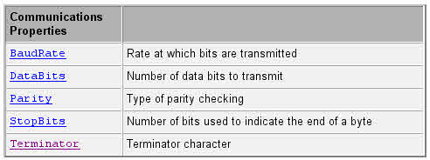
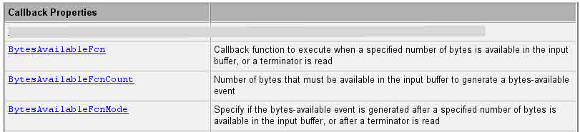
Serial properties

Slide 13
Important Serial Object Properties
We'll use these now:
BaudRate - Transmission speed
Terminator - Auto ending character (potential callback mech)
Timeout - How long does it try before giving up
Status - Determines if connected
We'll use these later:
BytesAvailable - Number of bytes available in the input buffer
BytesAvailableFcn - Callback function
BytesAvailableFcnMode - Determines when function is called
BytesAvailableFcnCount - Used if mode is number of bytes

Slide 14
Advanced Control - Event Callback
Example that we could've used with Plate Loader:
robot = serial('COM1', 'BaudRate', 19200,... 'TimeOut', 0.5,... 'Terminator', 10,... 'BytesAvailableFcnMode', 'terminator',... 'BytesAvailableFcn', @serial_robot_BytesAvailableFcn);
Then make a serial_robot_BytesAvailableFcn function.

Slide 15
serial_robot_BytesAvailableFcn
function serial_robot_BytesAvailableFcn(serialObj, eventData)
% Get time value - Optional time = eventData.Data.AbsTime; year = time(1);month = time(2);day = time(3);hour = time(4);minute = time(5);second = time(6); if (hour > 12) hour = hour - 12; amPm = 'pm'; elseif (hour == 0) hour = 12; amPm = 'am'; else amPm = 'am'; end
numChars = get(serialObj, 'BytesAvailable'); [charRead,numRead,errorMsg] = fread(serialObj,numChars,'char'); fprintf('On %d/%d/%d at %d:%0.2d%s (%d secs) received %d char(s) = %s \n',... month,day,year,hour,minute,amPm,second, numRead, char(charRead'));
end

Slide 16
Getting data out of the callback
In GUIDE
Pass in the handles structure to the callback function
Without GUIDE
Use Globals
I'm sure there are other slick methods.

